Slide 1
Introduction to Data Integration
Lauren Vanderlinden
BIOS 6660
Spring 2019

Slide 2
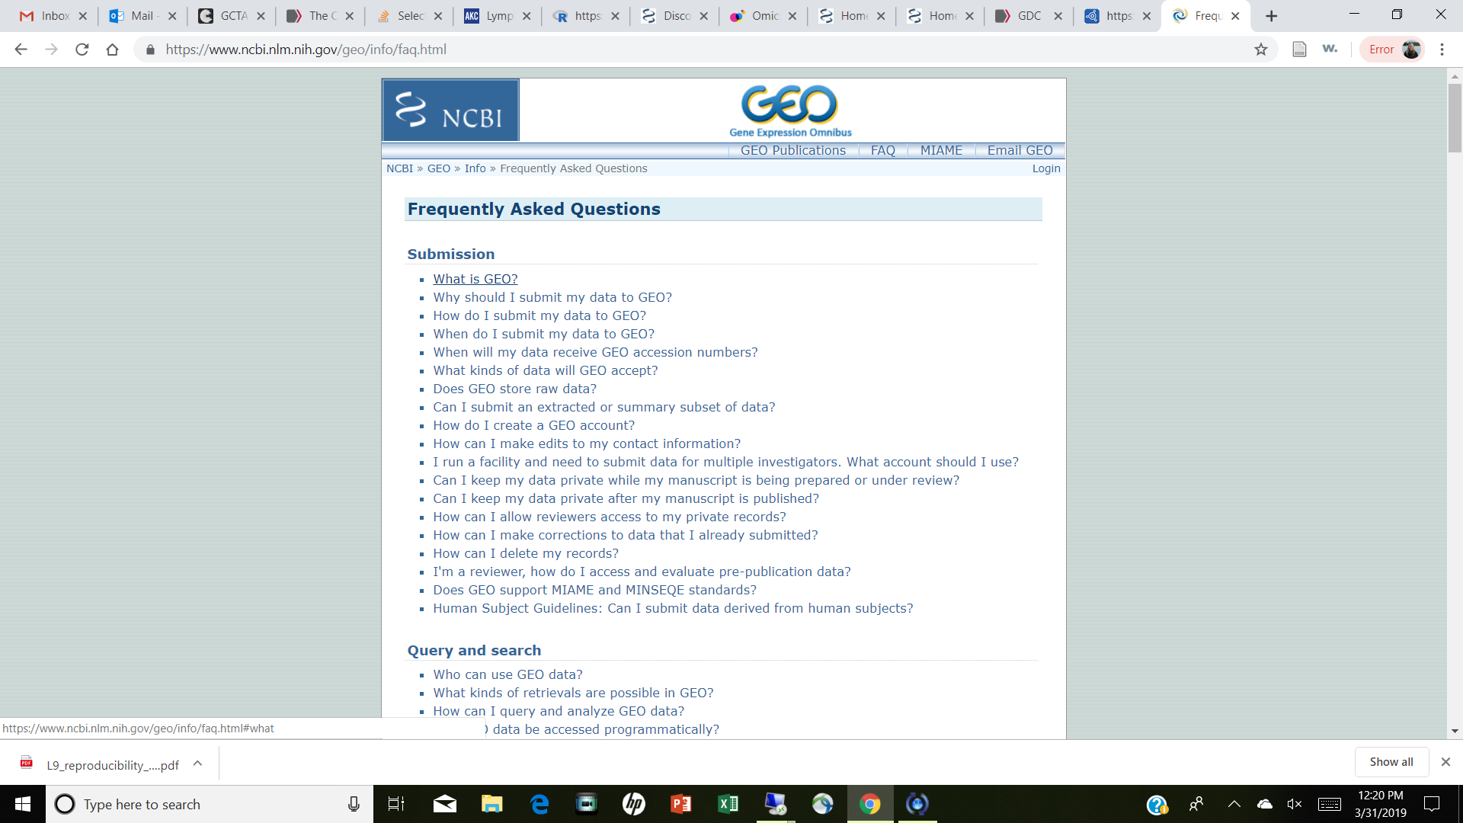
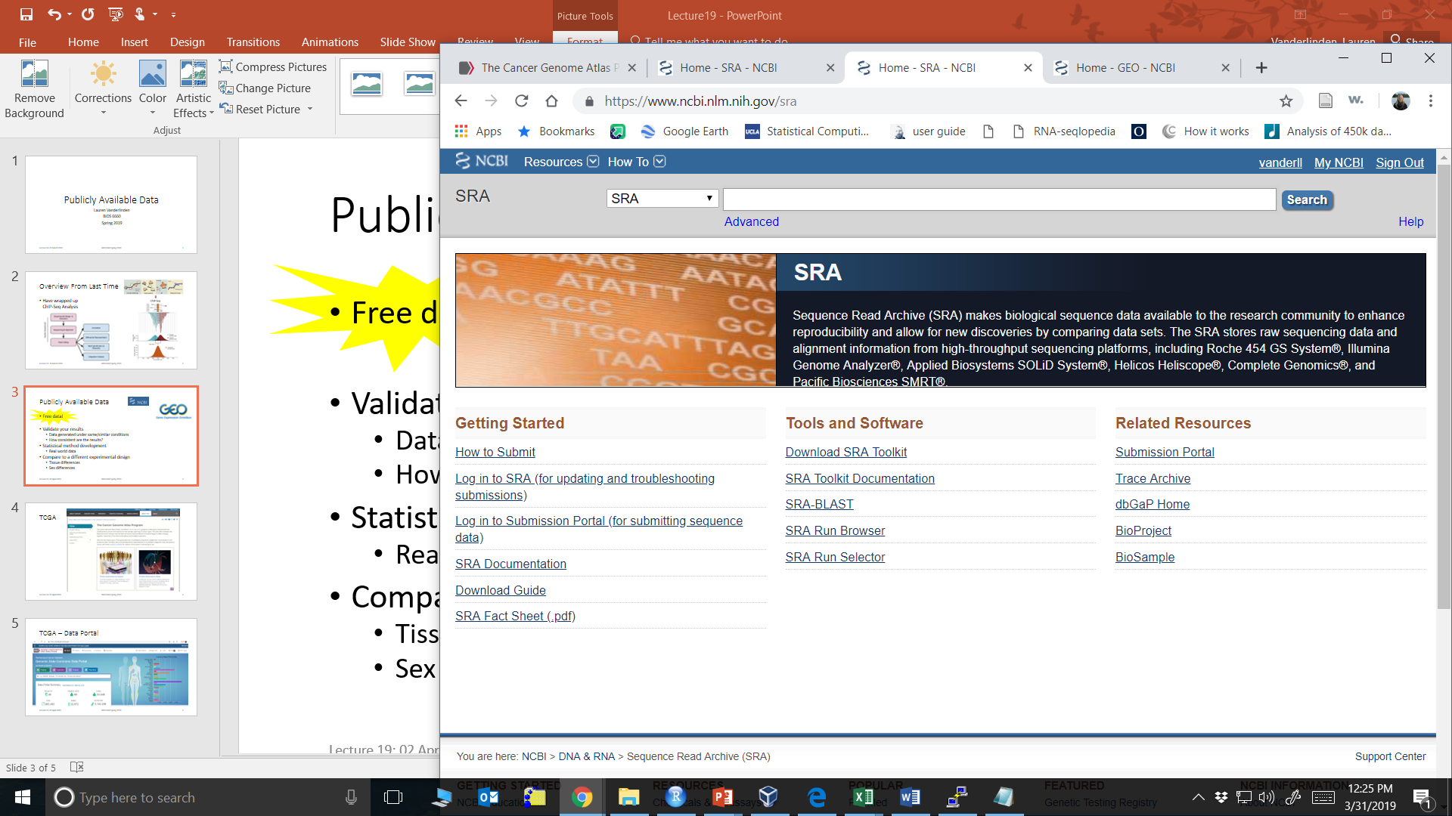



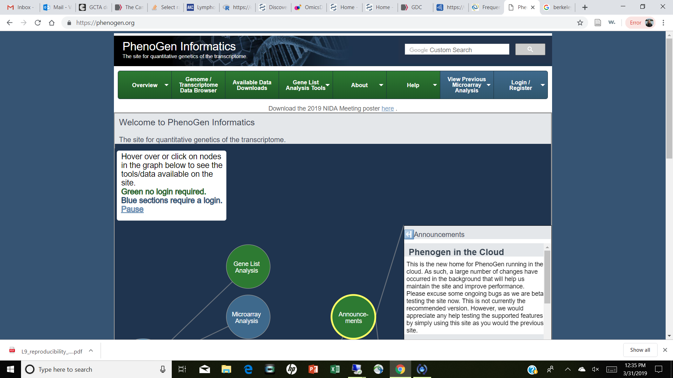
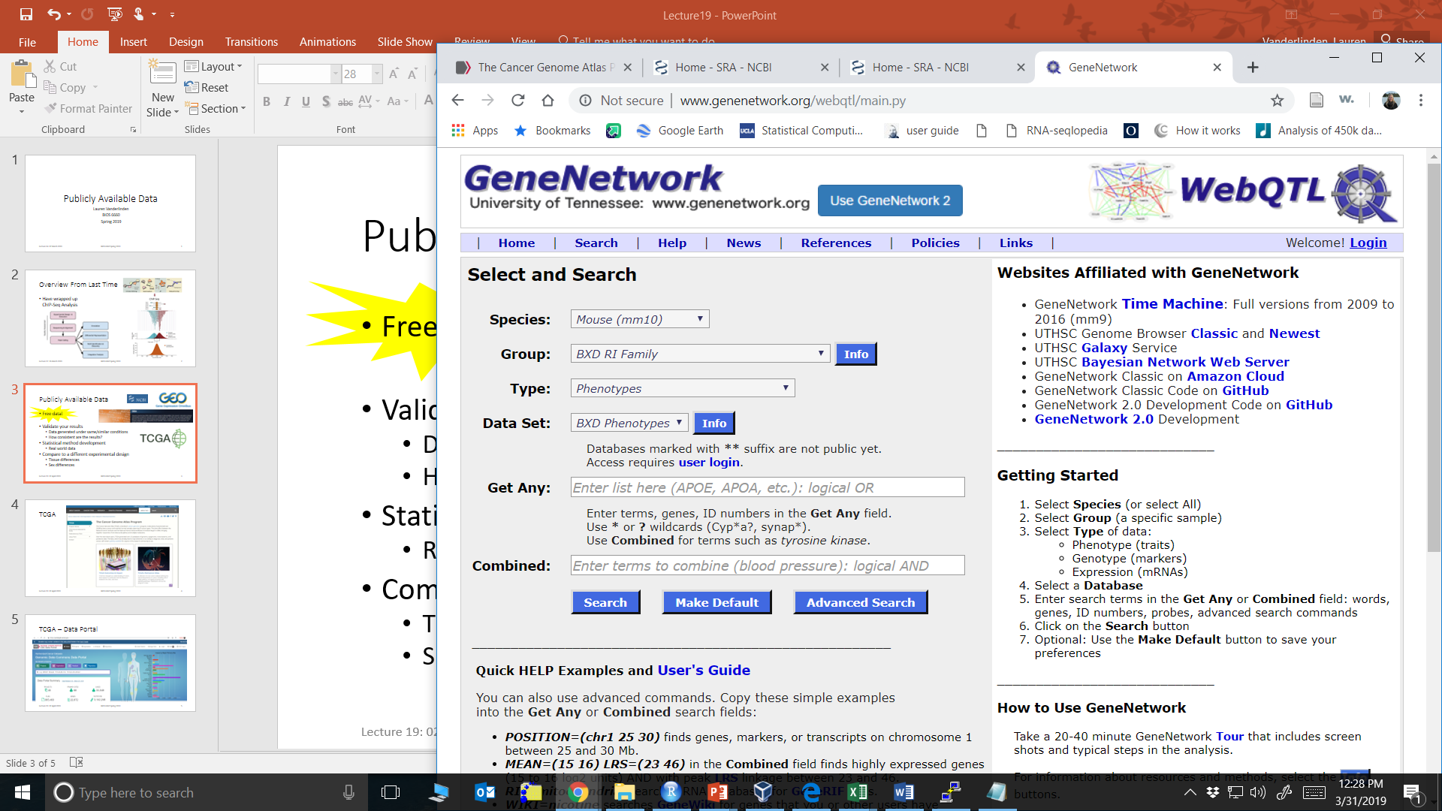
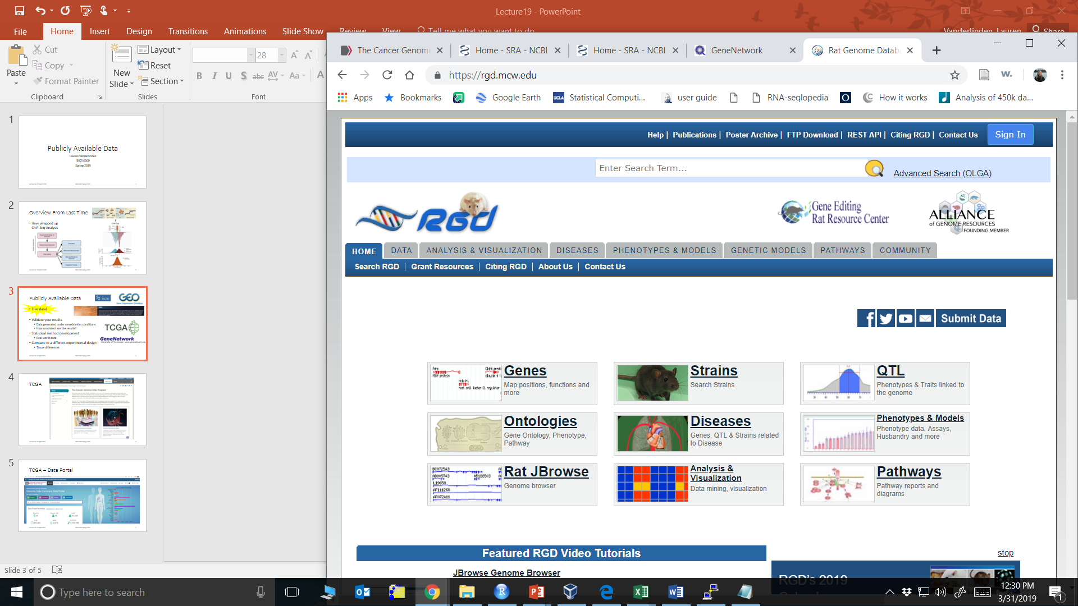
Overview From Last Time
Different databases
How to retrieve data in R
Gene signatures

Slide 3
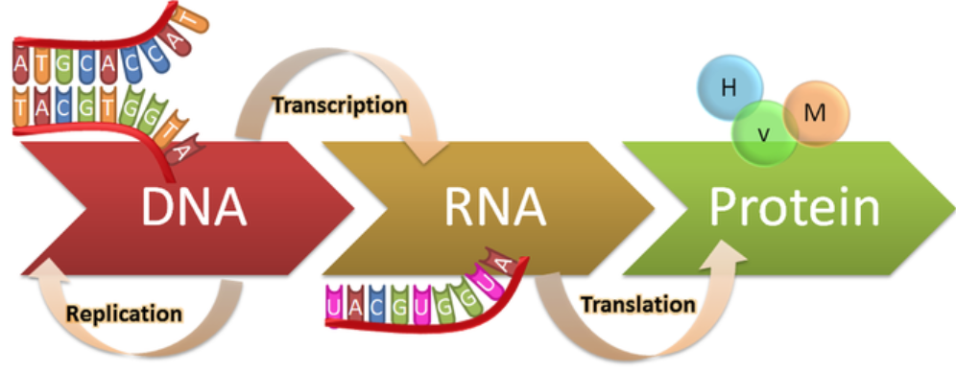
Multiple ‘Omics Datasets
Environment
Want to get a bigger picture on what is happening
Multiple ‘omics datasets
TF Binding Sites
Post Translational Modifications
Chromatin Remodeling
Epigenome
microbiome
Bio-chem
Pheno-types
Genome
Transcriptome
Proteome
Metabolome
Phenome

Slide 4
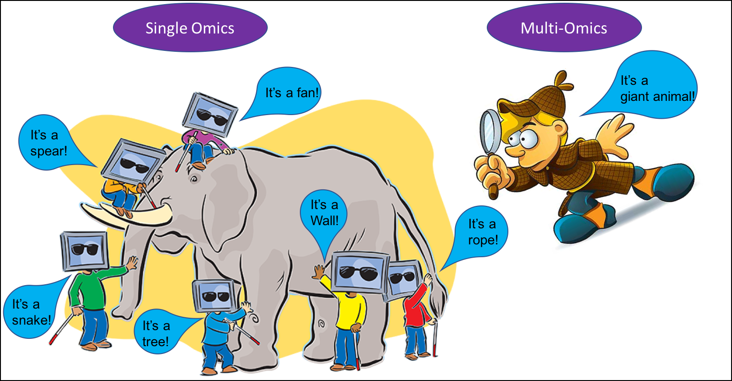
Source: Melgen

Slide 5
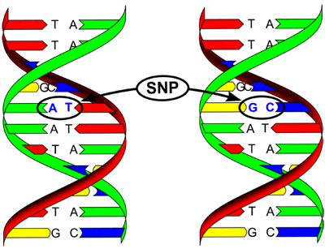
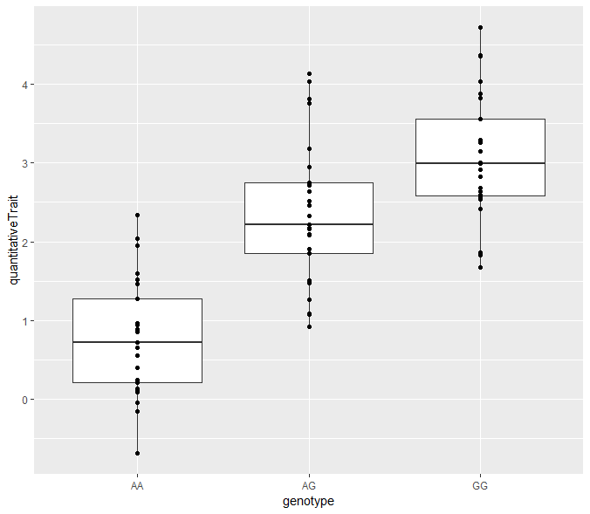
Integration with DNA
Most common form of data integration
DNA marker set of Single Nucleotide Polymorphisms (SNPs)
2 copies of chromosomes
Homozygous major allele (AA)
Heterozygous (AG)
Homogzygous minor allele (GG)
99.9% genome same among individuals
Easy to integrate with other ‘omics datasets tied to genome
mRNA
Proteomics
DNA methylation
Look at physically closest SNP or candidate marker
Source: Wikipedia

Slide 6
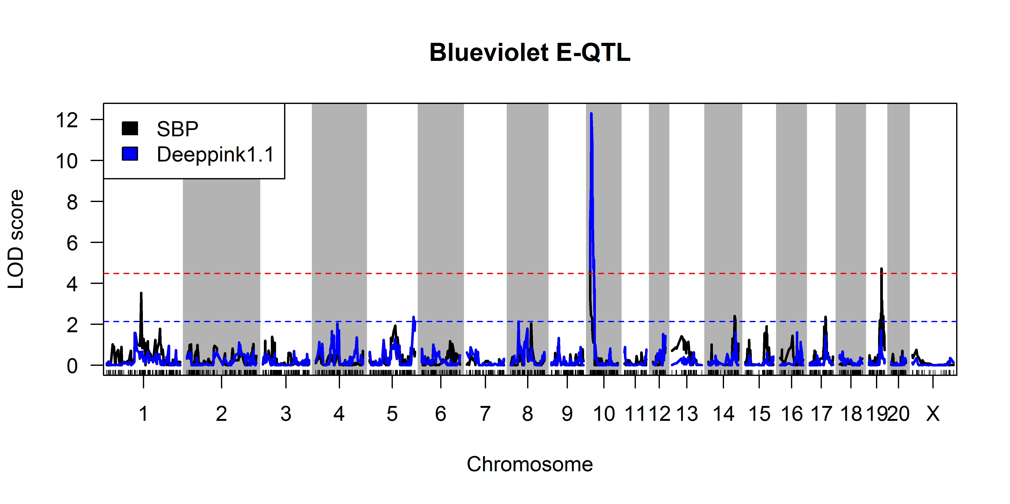
Quantitative Trait Loci (QTL) Mapping
Attempt to explain the genetic basis of variation in complex traits
Outcome is a continuous measure
Phenotype (pQTL)
Gene/Transcript Expression (eQTL)
Predictor is SNP marker
ANOVA at marker loci (marker regression):
Outcome = # Alleles (0, 1 or 2 value)
Outcome = Dominant Allele (0 or 1 value)
Repeat for each marker
Example QTL for both a phenotype (systolic blood pressure, black trace) and a candidate eigengene expression (from WGCNA, blue trace). Red and blue dotted lines show the genome-wide significant and suggestive thresholds for the eQTL.

Slide 7
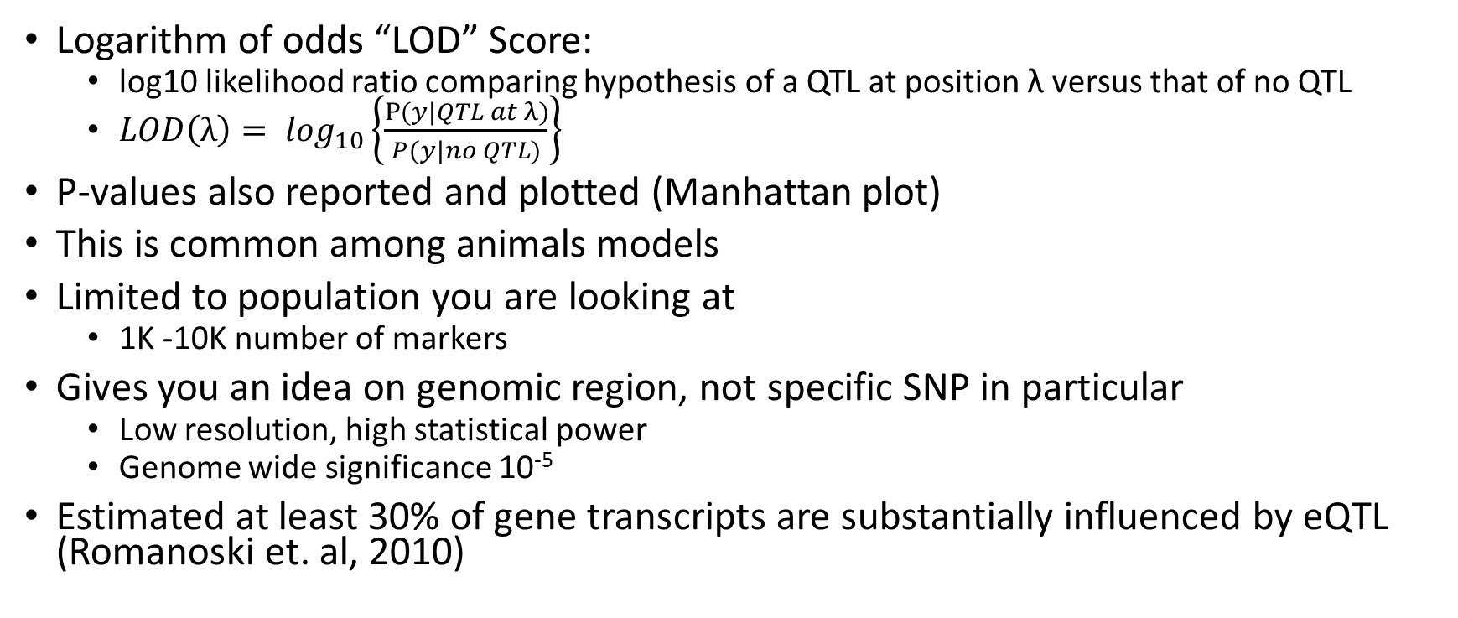
QTL Continued
Logarithm of odds “LOD” Score:
log10 likelihood ratio comparing hypothesis of a QTL at position λ versus that of no QTL
$LOD\left(λ\right)= \log_{10}\left\{\frac{P{(y|QTL at λ)}}{P(y|no QTL)}\right\}$
P-values also reported and plotted (Manhattan plot)
This is common among animals models
Limited to population you are looking at
1K -10K number of markers
Gives you an idea on genomic region, not specific SNP in particular
Low resolution, high statistical power
Genome wide significance 10⁻⁵
Estimated at least 30% of gene transcripts are substantially influenced by eQTL (Romanoski et. al, 2010)

Slide 8
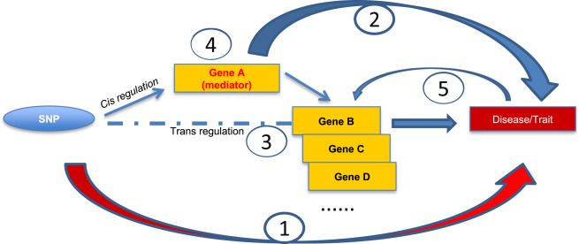
Cis vs Trans Regulation
Cis is genetic control from some SNP close to gene
Trans is genetic control from SNP far away from gene
You do see these eQTL “hotspots”
Source: Yao et al, 2017
missense SNP affects protein structure/function
non-coding SNP affects gene expression (cis)
non-coding SNP affects remote (trans) gene expression directly or by
cis-eGene mediation of the trans-eQTL-trans-eGene association; or
reverse causality (trait has feedback effect on gene expression).

Slide 9
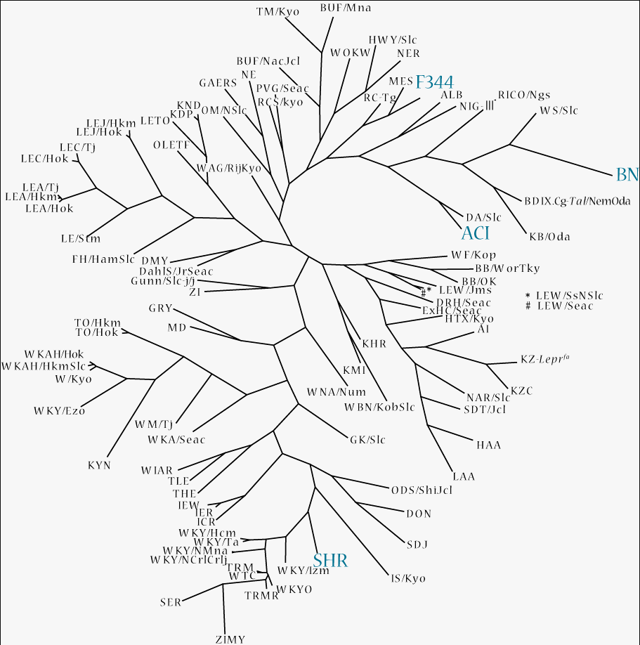
Population Stratification
Genetic Variant
(SNP)
Phenotype
?
Presence of systematic differences in allele frequencies between subpopulations in a population
Confounding by ethnicity
In marker regression, assuming samples are independent
Non-random mating between groups
Different relationships between each combination of strain (admixture)
True for the HRDP
In humans, physical separation (say African vs European vs Asian descent)
Genetic drift of allele frequencies in each group
Ethnicity
http://www.anim.med.kyoto-u.ac.jp/NBR/Images/phylogenetic_tree_132_200_2.png

Slide 10
QTL Mapping Software
R/qtl
R/emma (Efficient mixed-model association)
R/dlmap (Detection localization mapping for QTL)
R/mppR (Multi-parent population QTL analysis)
GEMMA (Genome-wide efficient mixed-model association)
Adjusts for population structure

Slide 11
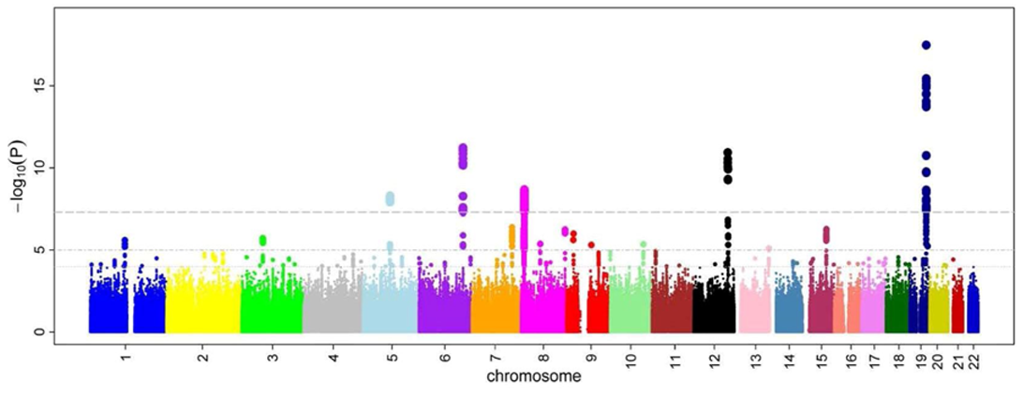
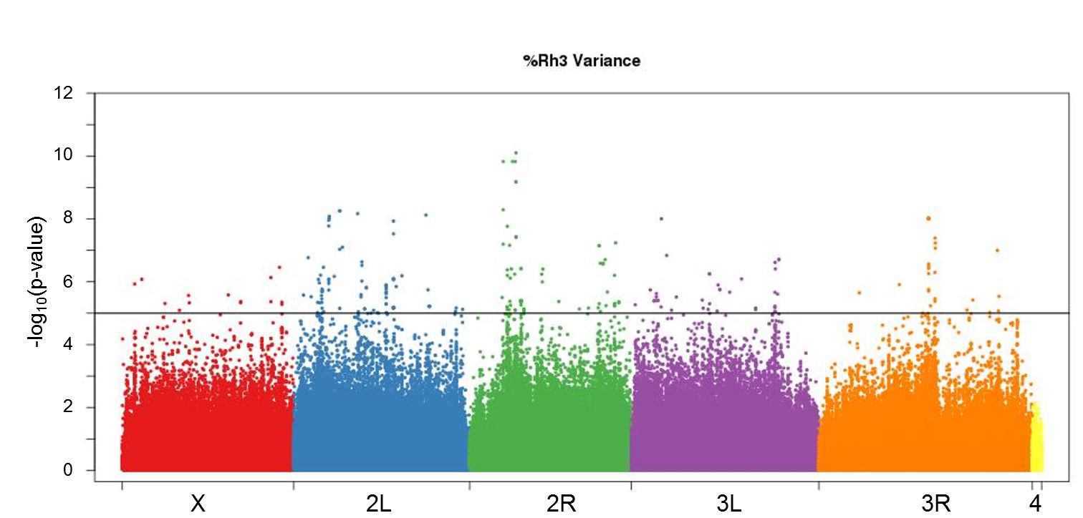
Genome-Wide Association Study (GWAS)
Can do this with continuous qualitative traits (like QTLs) or classification traits
Statistical model same, testing if SNP predicts outcome
Difference is a much more comprehensive set of markers
Millions of markers
High resolution, but lower statistical power
Genome wide significance 10⁻⁸
Software: plink
Source: wikipedia

Slide 12
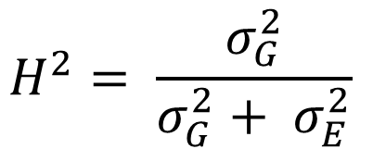
Heritability
$$H^{2}= \frac{σ_{G}^{2}}{σ_{G}^{2}+ σ_{E}^{2}}$$
Proportion of variability explained by genetics
Total Variance Trait = Genetic Variance + Environmental Variance
Always between 0 and 1, normally reported as a percent
If have DNA can estimate the heritability of trait (gene expression)
Dependent on the population you are studying
Ranges of heritability reported
Easy to calculate in animal models where different inbred strains used:
R² from a 1-way ANOVA: expression = strain

Slide 13
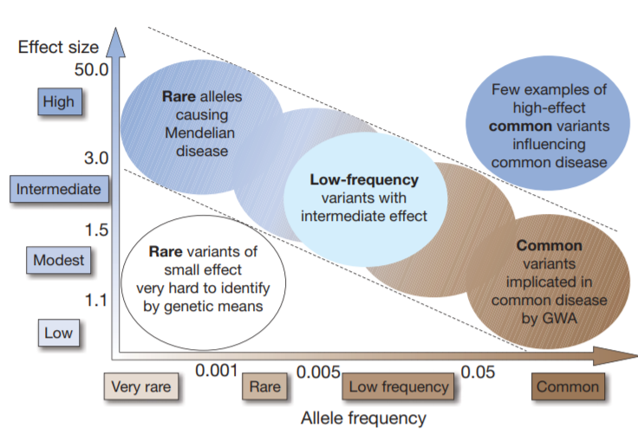
Missing Heritability
Twin and familial-based linkage studies estimate heritability
GWAS can account for only for a small proportion
Example: human height
Complex trait (numerous genetic loci involved) estimated heritability at LEAST 80% from familial studies
GWAS found 40 loci which IN TOTAL account for only 5% variation
For complex traits, each loci involved has a small effect size and hard to identify
Rare variants don’t have as much power due to sample size
Source: Manolio et. al, 2009

Slide 14
Epigenetic Effects & mRNA Expression
Easy to link because of location
Have ChIP peak in a range of gene’s TSS
DNA methylation and gene expression
Same samples: correlation (expect negative correlation)
Different samples: take candidate list of say differential methylated positions and see if there are differential expression in corresponding gene
miRNA and mRNA
Find the targets for miRNA
multiMiR (Dr. Katerina Kechris)
Look at correlation or candidates (yes/no)
http://multimir.ucdenver.edu/

Slide 15
LASSO to get miRNA-mRNA network
Datasets available:
miRNA dataset (~2,000)
mRNA dataset (~20,000)
miRNA can target multiple genes
Perform WGCNA on the mRNA dataset
Identify miRNA(s) that regulate module by performing LASSO using eigengene as outcome and miRNAs as predictors
Need to have same samples in both datasets

Slide 16
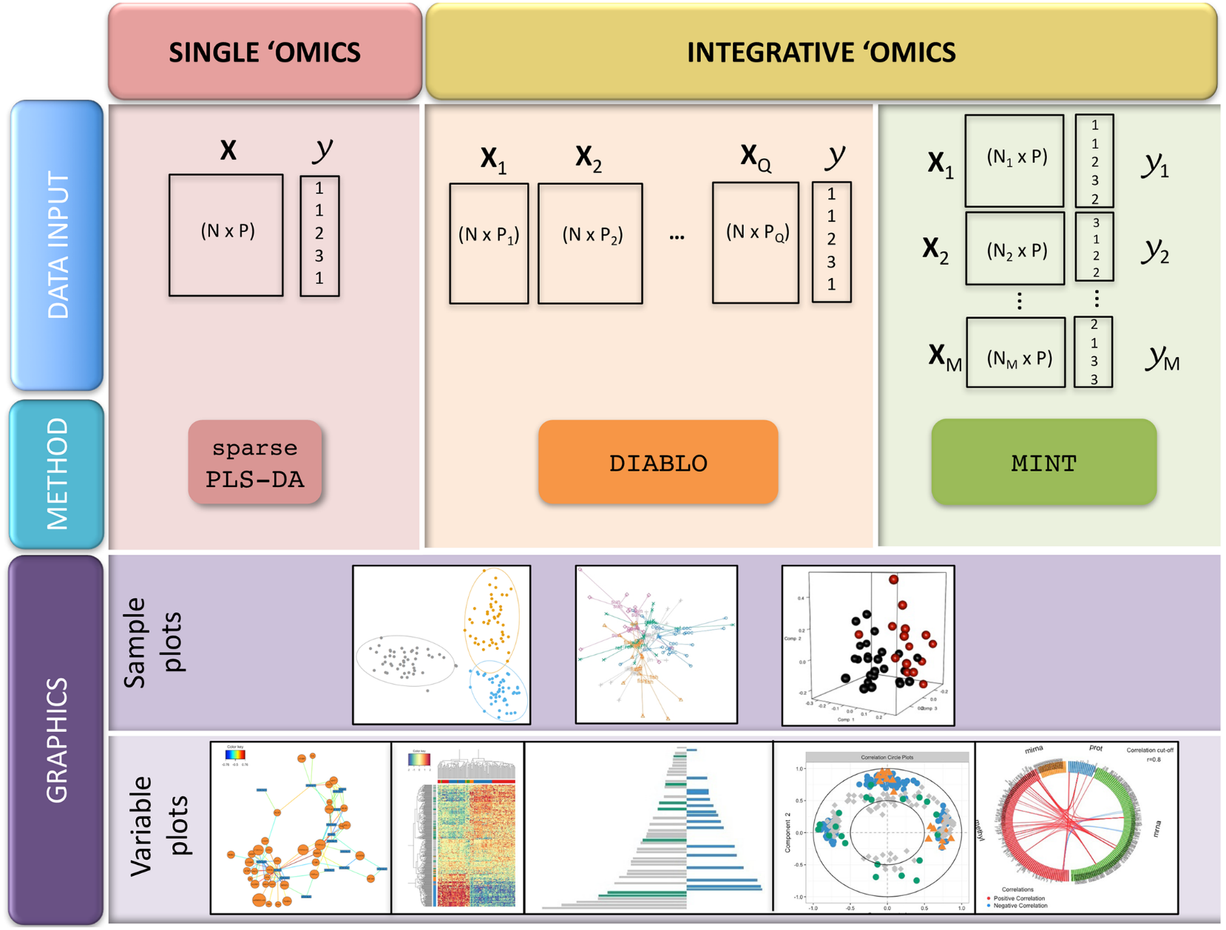
R/mixOmics
Feature Selection
Data integration
Supervised analysis
Classify or discriminate sample groups
Sparse Partial Least Squares Discriminant analysis (sPLS-DA)
Original 1 dataset approach
DAIBLO
Integration of same biological samples (N) measured on different platforms
N-integration
MINT (Meta Analysis)
Integration of independent datasets on measured on same predictors
P-integration

Slide 17
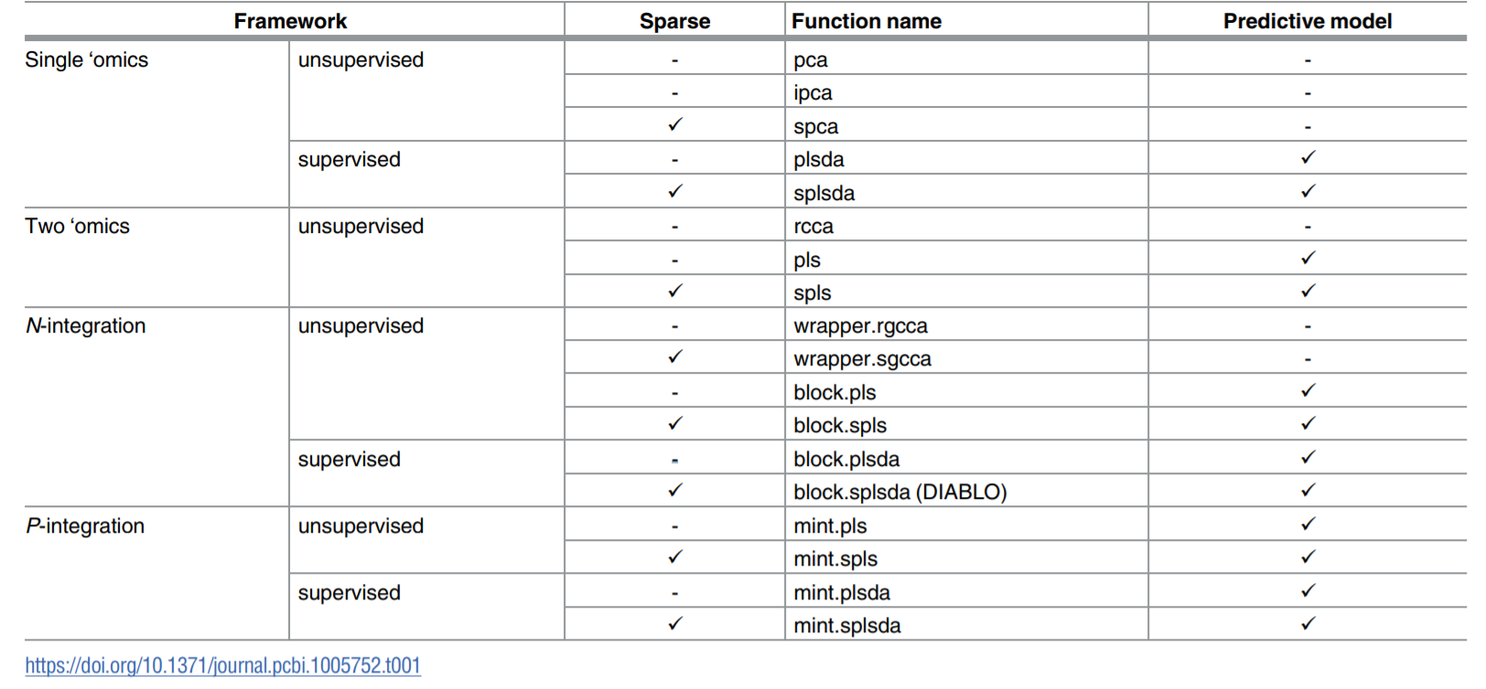
Methods Available in mixOmics

Slide 18
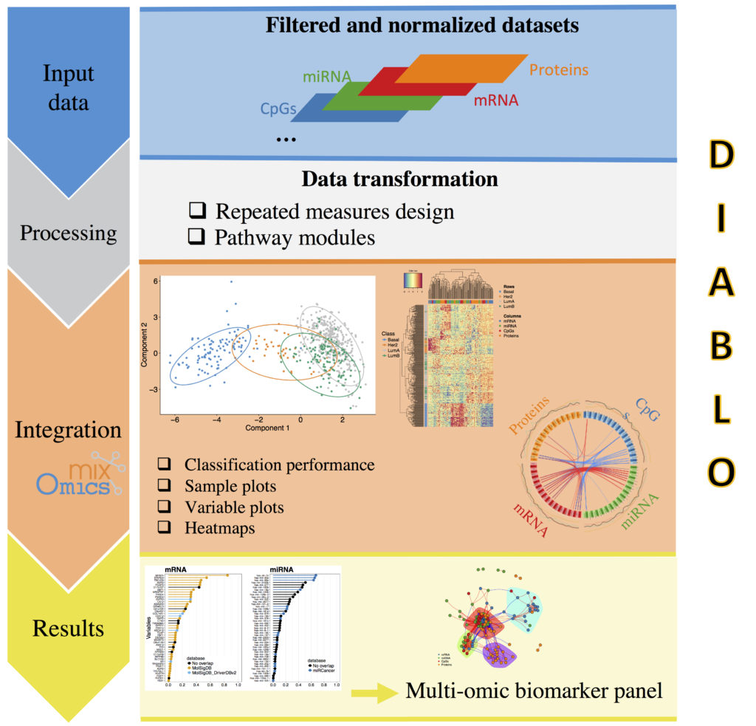
DIABLO
Data Integration Analysis for Biomarker discovery using Latent variable approaches for ‘Omics studies
Builds on
generalized canonical correlation analysis (CCA)
Sparse sGCCA method

Slide 19
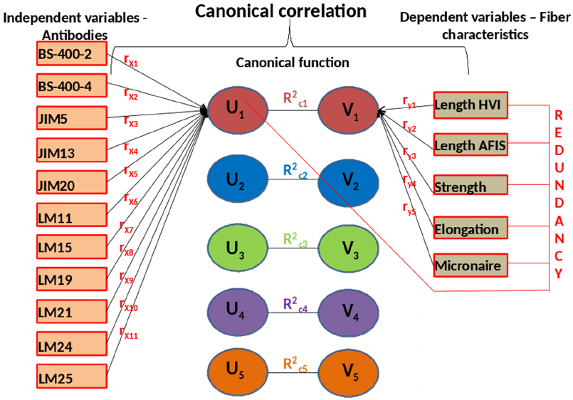
Canonical Correlation Analysis (CCA)
Multivariate correlation
Accounts for multi-collinearity
Features in a dataset not independent
Know not all genes are independent from each other
Compare sets of variables to sets of variables
Canonical loadings
Variables relationship to own set
E.g. gene A expression to gene B expression
Canonical weight
Variables relationship to other set
E.g. gene A expression to miRNA X expression
Canonical Cross-loadings
Variables relationship to other set
E.g. gene A expression to whole miRNA set CONSIDERING all of gene A’s other interaction with other genes in it’s own set
Canonical loadings and cross-loadings are called structure coefficients
Canonical weight is a function coefficient
Canonical correlation is the correlation between sets
Redundancy coefficients
Shared loading variance (variance explained within set)
Shared cross-loading variance (variance explained between sets)
Source: Rajasundaram et. Al, 2014

Slide 20
Sparse Multiple Canonical Correlation Network Analysis (SmCCNet)
R/SmCCNet
Congrat to Drs. Katerina Kechris & Jenny Shi!
CCA: Relationship between 2 multivariate datasets measured on same samples
E.g. Gene A to Gene B within mRNA dataset
Multiple: multiple ‘omics datasets
miRNA and mRNA
Sparse: not expecting many connections
Source: Katerina Kechris

Slide 21
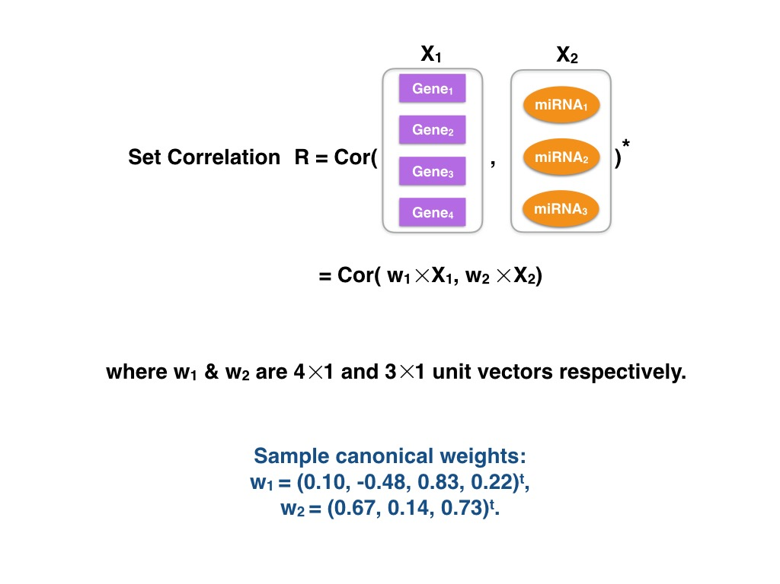
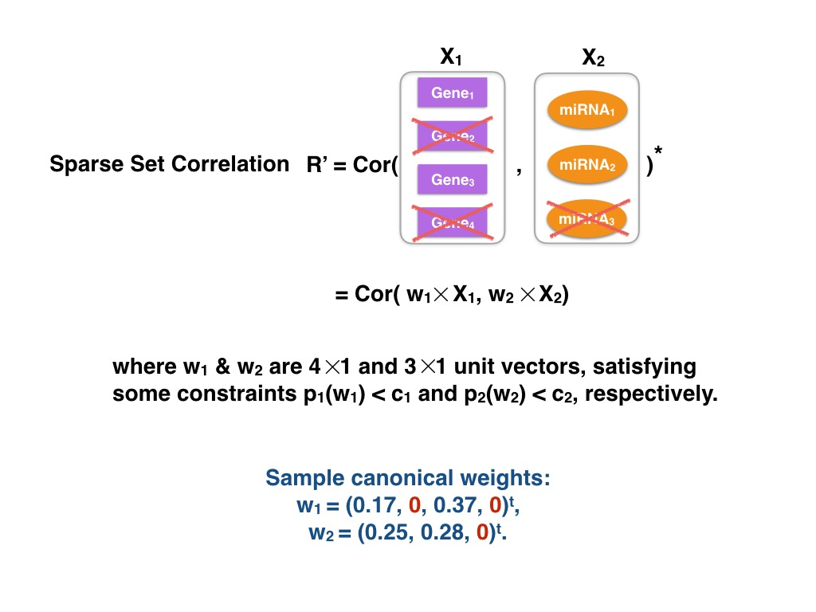
CCA vs Sparse CCA
Source: Katerina Kechris

Slide 22
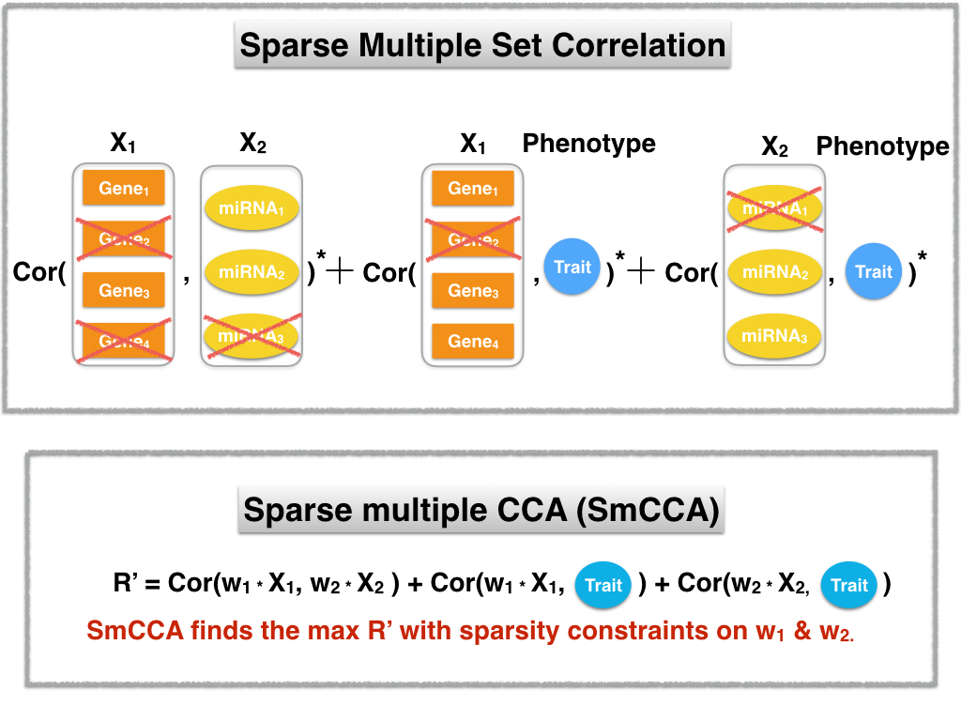
SmCCA
Subsampling of miRNA/mRNA & cross-validation of samples for sparse penalties on weights
Source: Katerina Kechris

Slide 23
Mediation Analyses
M
Observe a relationship between independent (X) and dependent variables (Y)
Mediator (M) is in the causal pathway of X -> Y
Complete & partial mediation
We have seen something like this!
Build on this an get Directed Acyclic Graph (DAG)
X
Y
DNA
RNA
Protein

Slide 24
Mediation Example 1
Dietary
Metabolites
DNA methylation
T1D
Find what metabolites best represent dietary information
Candidates from metabolites -> (T1D)
Candidates from DNA methylation -> T1D
Candidates from metabolites -> DNA methylation
See resulting combinations of metabolites, DNA methylation sites left
Perform a traditional Baron & Kenny (et al, 1986) between 3 combos
Significant X -> Y (model Y = X)
Significant M -> Y (model Y = M)
Non-significant X coefficient (complete mediation) in Y = X + M
Big thing is filtering down to a reasonable amount of combinations

Slide 25
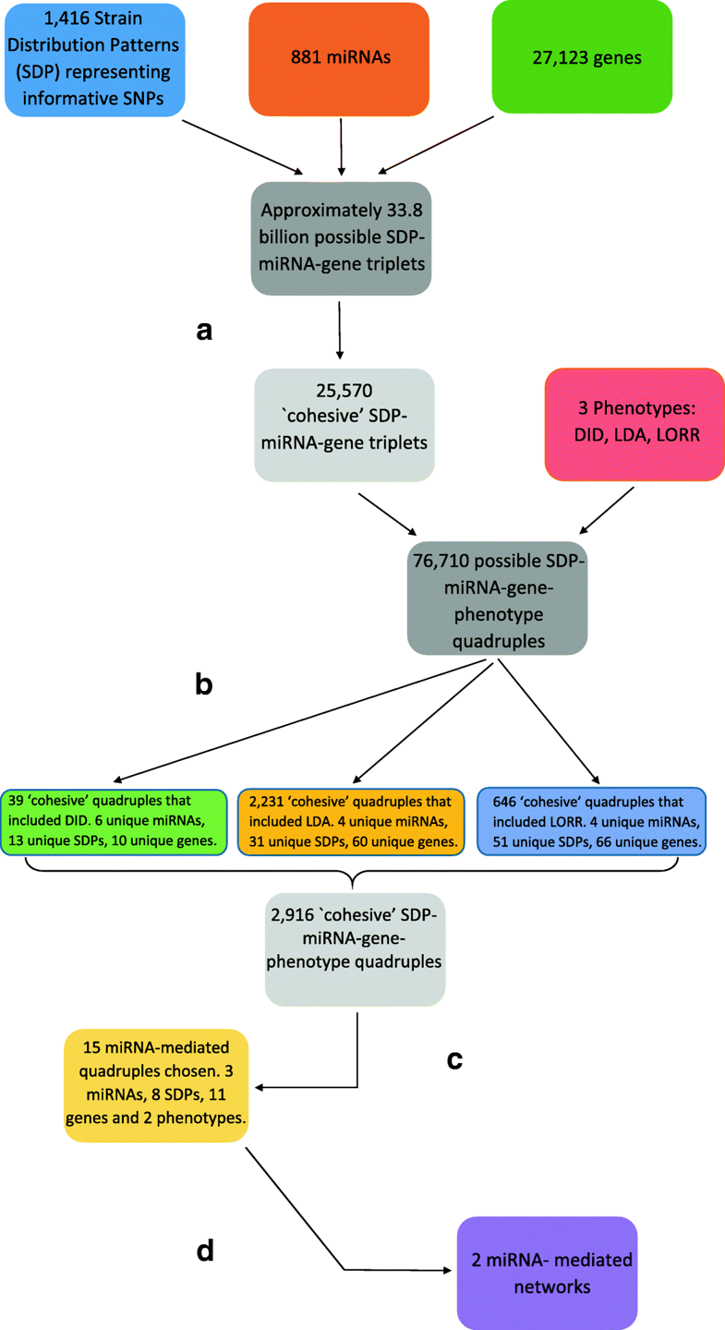
Mediation Example 2
DNA
miRNA
mRNA
EtOH Pheno
Source: Rudra et. al, 2018

Slide 26
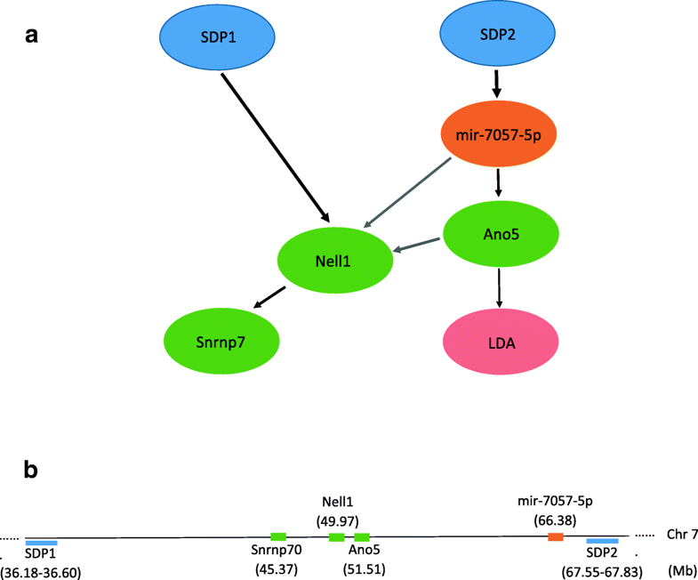
Mediation Example 2
Bayesian networks adds the arrows between nodes of same dataset
Ideal for taking an event that occurred and predicting the likelihood that any one of several possible known causes was the contributing factor
Computationally intensive
Once again, start small and build up
Source: Rudra et. al, 2018

Slide 27
Other Integration Software
R/Omic
R/integrOmics
R/ STATegRasPLS
R/OMICsPCA
R/MultiAssayExperiment
R/iCluster
R/CNAmet
R/OmicKriging
matlab/JIVE
JAVA/OmicsAnalyzer
JAVA/VANTED
JAVA/Lemon-Tree
C++/DASS-GUI
C++/GeneTrail2
Perl/3Omics
Perl and Python/PaintOmics

Slide 28
References
Romanoski CE, Lee S, Kim MJ, Ingram-Drake L, Plaisier CL, Yordanova R, Tilford C, Guan B, He A, Gargalovic PS, Kirchgessner TG, Berliner JA, Lusis AJ. Systems genetics analysis of gene-by-environment interactions in human cells. Am J Hum Genet. 2010 Mar 12;86(3):399-410.
Yao C, Joehanes R, Johnson AD, Huan T, Liu C, Freedman JE, Munson PJ, Hill DE, Vidal M, Levy D. Dynamic Role of trans Regulation of Gene Expression in Relation to Complex Traits. Am J Hum Genet. 2017 Apr 6;100(4):571-580.
Manolio TA. et al, Finding the missing heritability of complex diseases. 08 October 2009 Nature volume 461, pages 747–753.
Rajasundaram D, Runavot JL, Guo X, Willats WG, Meulewaeter F, Selbig J. Understanding the relationship between cotton fiber properties and non-cellulosic cell wall polysaccharides. PLoS One. 2014 Nov 10;9(11):e112168.
Baron, R. M. and Kenny, D. A. (1986) "The Moderator-Mediator Variable Distinction in Social Psychological Research – Conceptual, Strategic, and Statistical Considerations", Journal of Personality and Social Psychology, Vol. 51(6), pp. 1173–1182.
Rudra P, Shi WJ, Russell P, Vestal B, Tabakoff B, Hoffman P, Kechris K, Saba L. Predictive modeling of miRNA-mediated predisposition to alcohol-related phenotypes in mouse. BMC Genomics. 2018 Aug 29;19(1):639.

